Slide 1


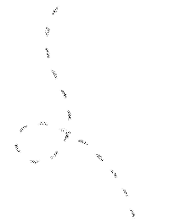




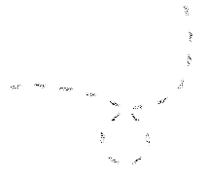

University of arizona
Among Us Assignment
Educational Courseware Template

Slide 2
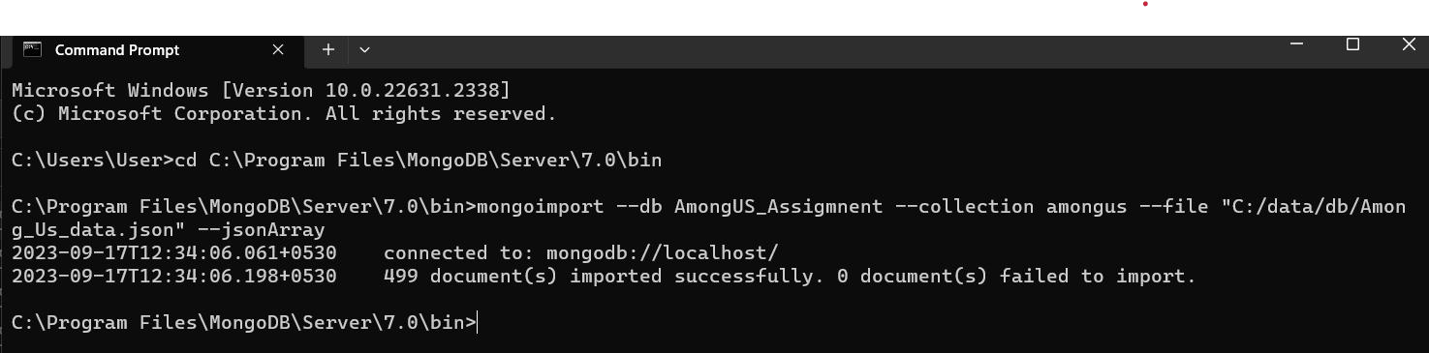
Question 1.1 - Read in the data using the mongoimport command.
Command –
C:\Program Files\MongoDB\Server\7.0\bin>mongoimport --db AmongUS_Assigmnent --collection Game -- file "C:\data\db\Among_Us_data.json" --jsonArray
Output Screenshot -

Slide 3
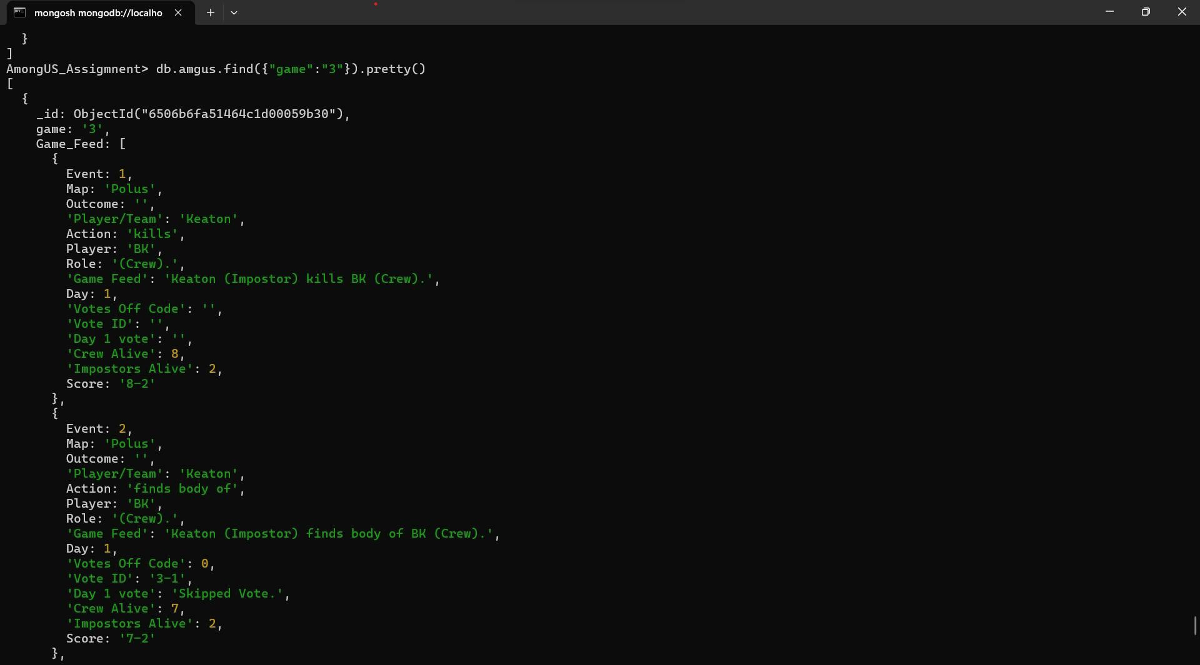
Question 1.2 - Display data for the match with “game” = “3”
Command –
AmongUS_Assigmnent> db.amgus.find({"game":"3"}).pretty()

Slide 4
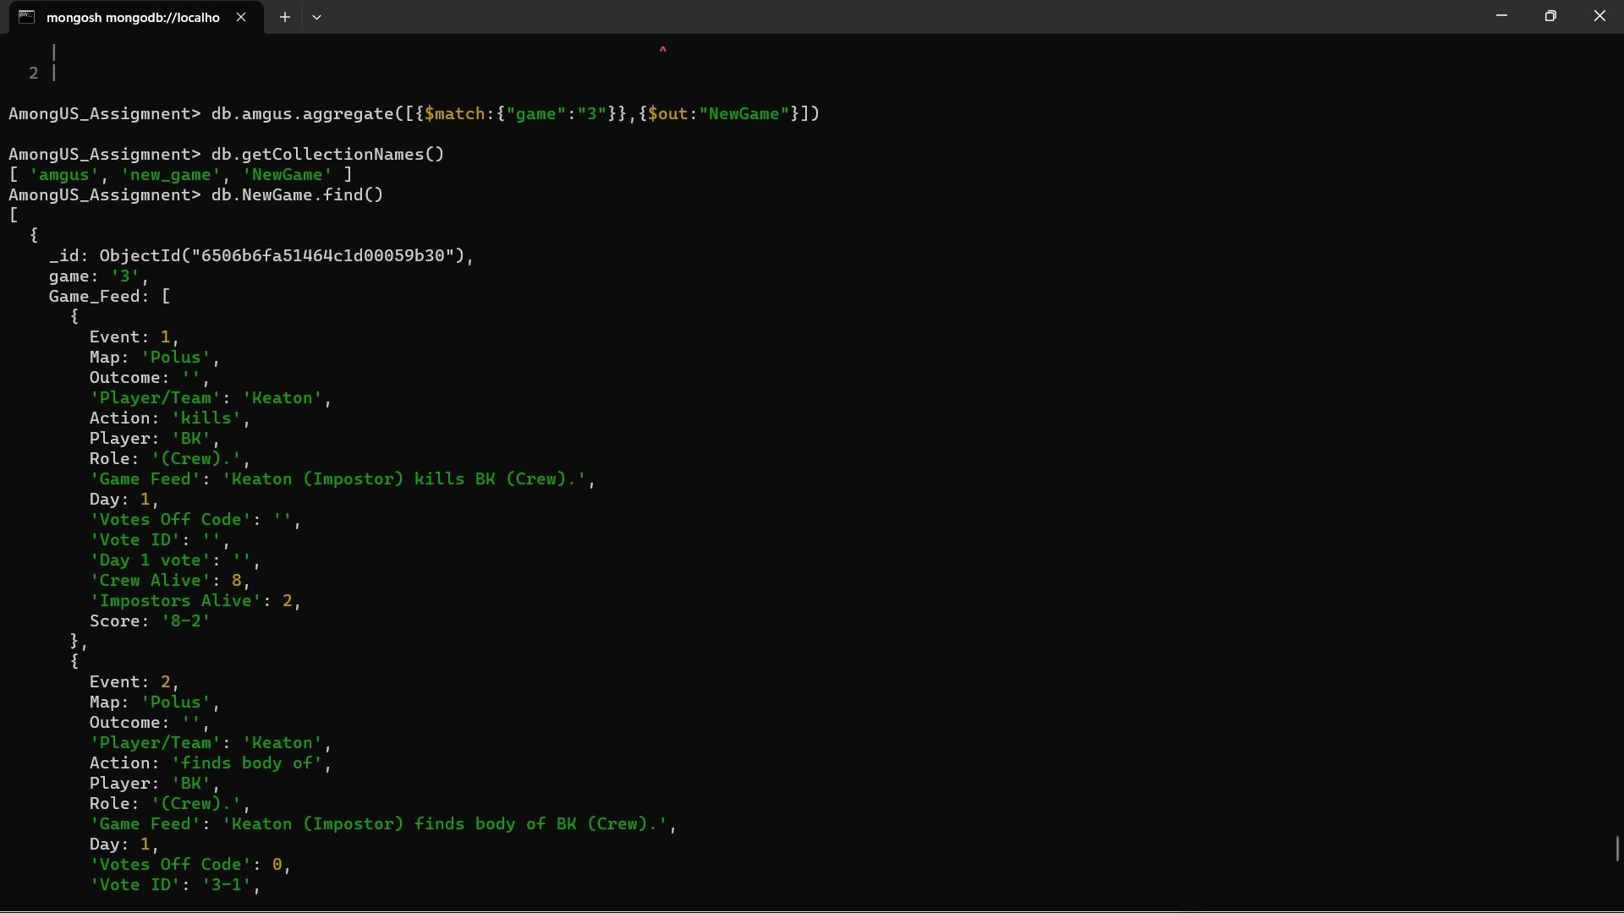
Question 2 – Explore Data - create a new collection with only the document relating to game 3.
Command –
AmongUS_Assigmnent> db.amgus.aggregate([ { $match: { "game":"3" } }, { $out: "NewGame" } ]) AmongUS_Assigmnent> show collections
Game Game3

Slide 5
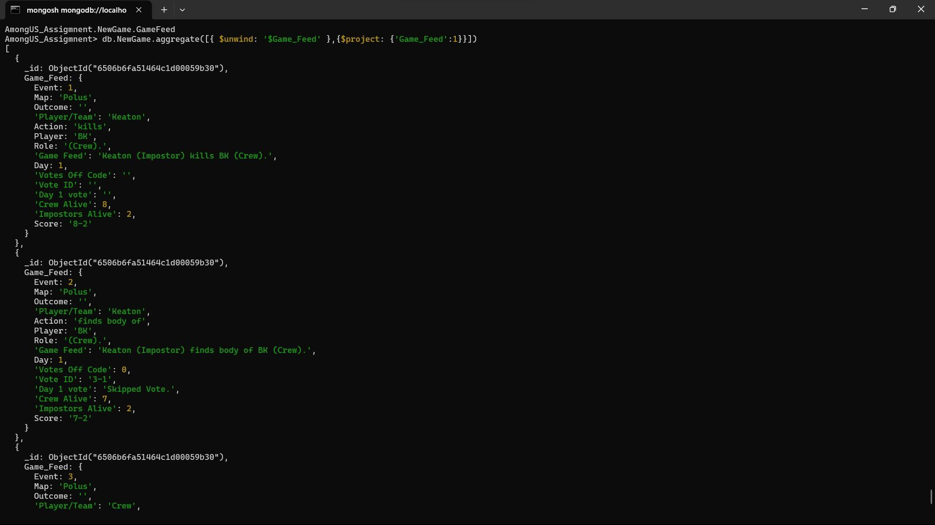
Question 2.1 – Display the Game Feed data for the game in the new collection.
Command –
AmongUS_Assigmnent> db.NewGame.aggregate([{ $unwind: '$Game_Feed' },{$project: {'Game_Feed':1}}])

Slide 6
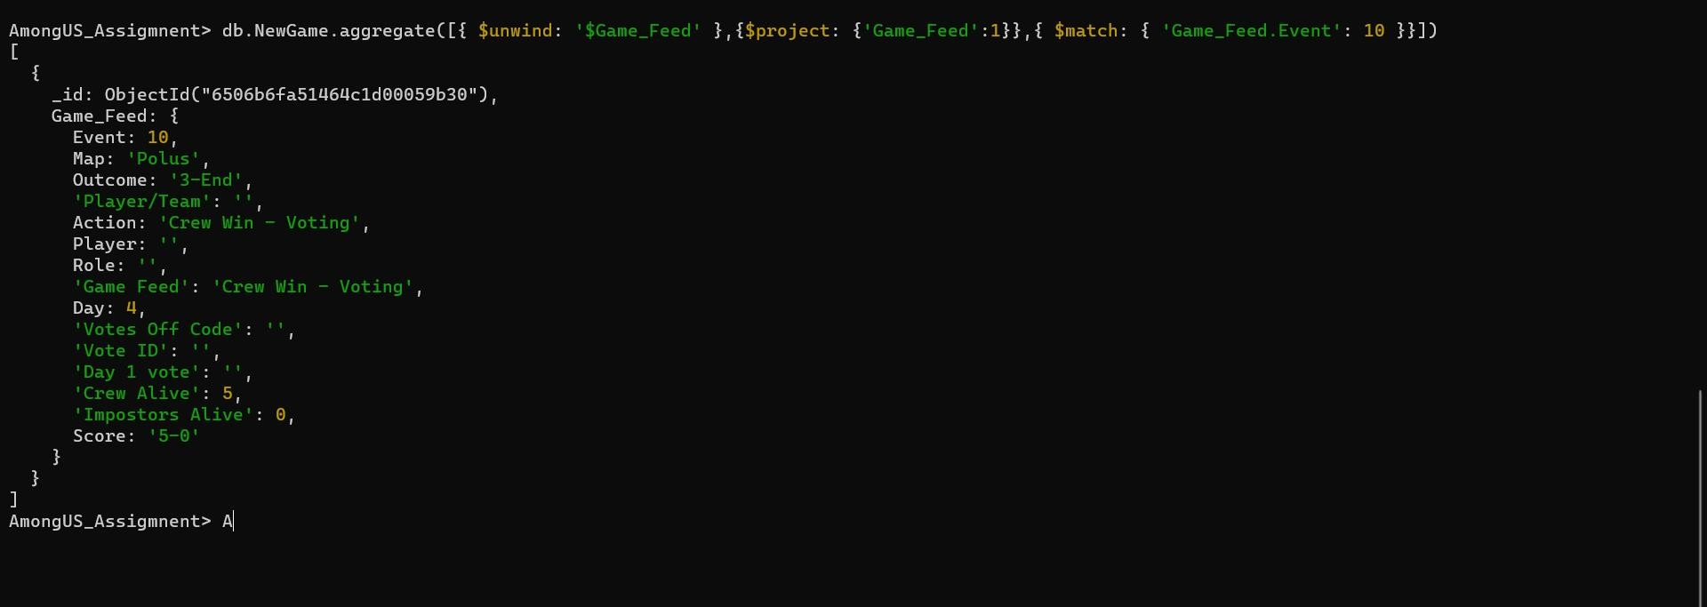
Question 2.2 – Display the last event in game 3.
Command –
db.NewGame.aggregate([{ $unwind: '$Game_Feed' },{$project: {'Game_Feed':1}},{ $match:
{ 'Game_Feed.Event': 10 }}])

Slide 7
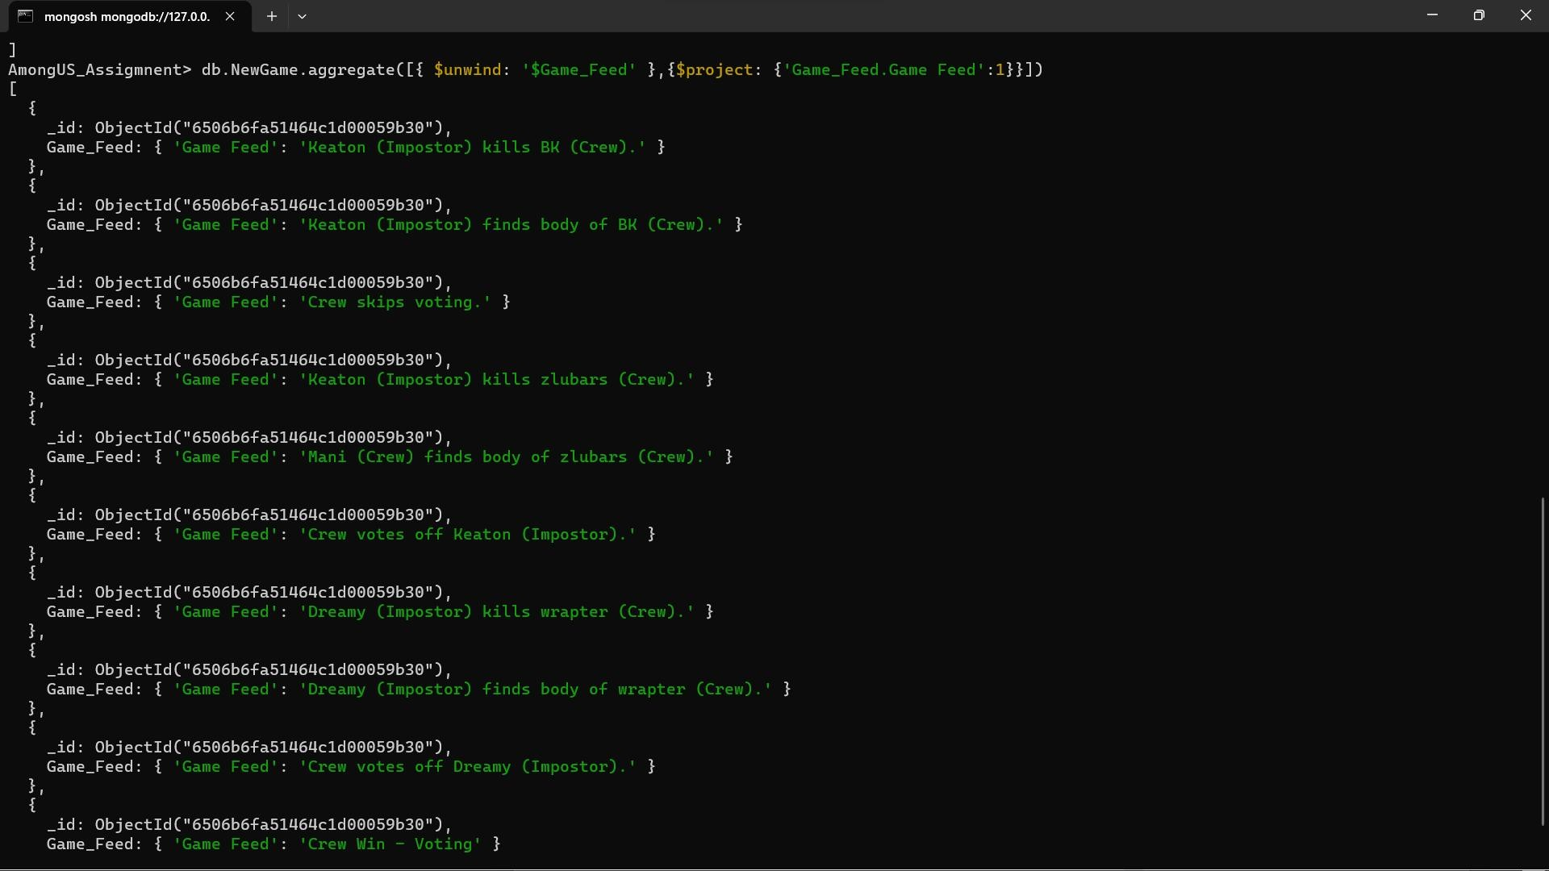
Question 2.3 – Who won game 3, imposters or crew?
Command –
db.NewGame.aggregate([{ $unwind: '$Game_Feed' },{$project: {'Game_Feed.Game Feed':1}}])
Answer - Crew wins by voting

Slide 8
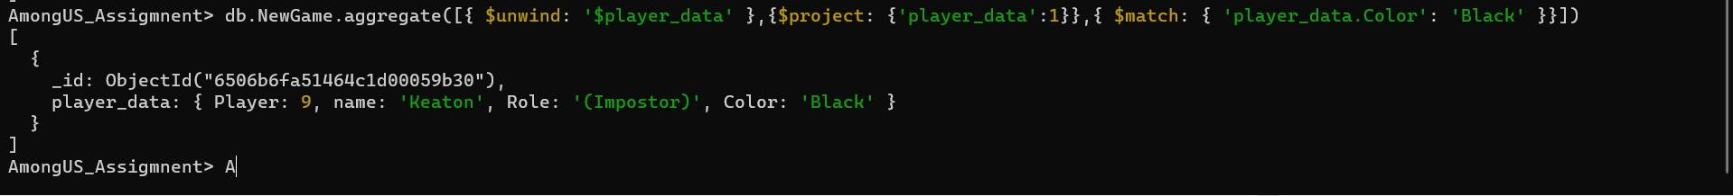
Question 2.4 – Who picked the black color in game 3? Was that player crew or imposter?
Command –
db.NewGame.aggregate([{ $unwind: '$player_data' },{$project: {'player_data':1}},{ $match:
{ 'player_data.Color': 'Black' }}])
Answer – Impostor Keaton picked black color

Slide 9
Question 2.5 – How many voting events happened in game 3?
Command –
AmongUS_Assigmnent> db.NewGame.aggregate([{ $unwind: '$voting_data' },{$project:
{'voting_data.Vote_Event':1}},{$group: {_id:null,count:{$sum:1}}}])
Answer – 24 voting event occurred in Game 3

Slide 10
Question 2.6 – This task was focused on exploring a single document. As explained earlier the
document is made of 4 main fields and three of those are nested and hold a lot of data.
If you were to redesign this database to make it easier to query, what changes would you make to the structure? Explain your design decisions. Do not modify the structure, simply explain the changes you want to make and justify them.
Answer – Create 4 collections. Game collection will have references to other collections via Game id. Using multiple collections should make the queries efficient.
Game
Game Feed
Player Data
Voting Data
id
Game_Feed_id
Player_Data_ID
Voting_Data_ID
Game_id
Game_Feed_id
Event
Game_id
Player_Data
Game_id
Voting_data

Slide 11
Overall Aggregation

Slide 12
Question 3.1 - How many events in total do you have data for, in this collection (across all games)? An event as explained earlier is a record of development in the game.
Command – AmongUS_Assigmnent> db.amgus.aggregate([{ $unwind:
'$Game_Feed' },{$project: {'Game_Feed':1}},{$group: {_id:null,count:{$sum:1}}}])
Answer – Total of 5889 events exist in all games

Slide 13
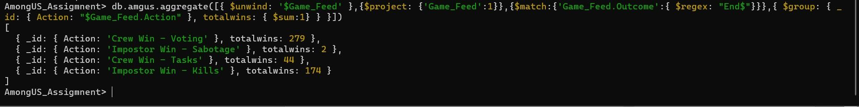
Question 3.2 - How many matches did the crew win versus how many matches did the impostors win?
Command – AmongUS_Assigmnent>db.amgus.aggregate([{ $unwind: '$Game_Feed' },{$project:
{'Game_Feed':1}},{$match:{'Game_Feed.Outcome':{ $regex: "End$"}}},{ $group: { _id:
{ Action: "$Game_Feed.Action" }, totalwins: { $sum:1} } }])
Answer –
1. Crew Wins – 323 (279+44)
2. Imposter Wins - 176 (2+174)

Slide 14
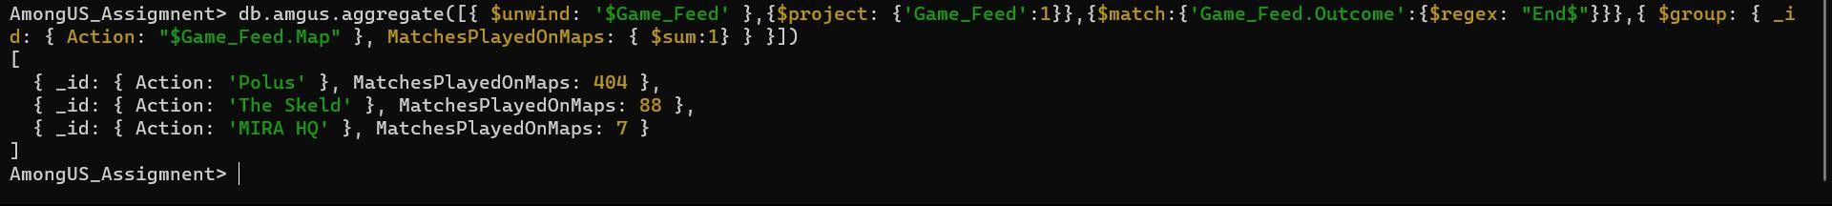
Question 3.3 - Find out how many matches were played on each map. Your output should contain the names of maps and the number of games played on each map0ap.
Command – db.amgus.aggregate([{ $unwind: '$Game_Feed' },{$project:
{'Game_Feed':1}},{$match:{'Game_Feed.Outcome':{$regex: "End$"}}},{ $group: { _id: { Action: "$Game_Feed.Map" }, MatchesPlayedOnMaps: { $sum:1} } }])
Answer – # of Matches played on each map is
The Skeld – 88 Matches
MIRA HQ – 7 Matches
Polus – 404 Matches

Slide 15
Question 3.4 - How many times in total across all games did the crew skip a vote?
Command – db.Game.aggregate([{ $unwind: '$Game_Feed' },{$project:
{'Game_Feed':1}},{$match:{'Game_Feed.Game Feed':'Crew skips voting.'}},{$group:
{_id:null,count:{$sum:1}}}])
Answer – The crew skipped voting 692 times

Slide 16
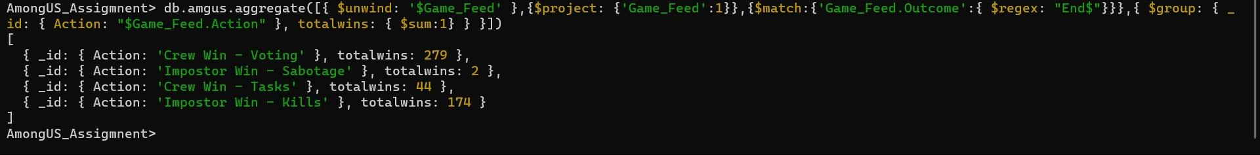
Question 3.5 - How many times in total across all matches does the crew vote against imposters?
Command – AmongUS_Assigmnent>db.amgus.aggregate([{ $unwind: '$Game_Feed' },{$project:
{'Game_Feed':1}},{$match:{'Game_Feed.Outcome':{ $regex: "End$"}}},{ $group: { _id:
{ Action: "$Game_Feed.Action" }, totalwins: { $sum:1} } }])
Answer – The crew wins voting 279 times

Slide 17
Question 3.6 - The questions you answered in this task were all related to high-level aggregations across the entire collection. In your opinion, is the game more or less hard for impostors? Justify your answer with suitable insights from the data.
Command – AmongUS_Assigmnent>db.amgus.aggregate([{ $unwind: '$Game_Feed' },{$project:
{'Game_Feed':1}},{$match:{'Game_Feed.Outcome':{ $regex: "End$"}}},{ $group: { _id:
{ Action: "$Game_Feed.Action" }, totalwins: { $sum:1} } }])
Answer – Imposter won 35.27% (176 out of 499) of the time and Crew won 64.7% (323 out of 499). Since the odds of winning by Crew is ~65%, the game is hard for imposters.

Slide 18
Player-Level Aggregation

Slide 19
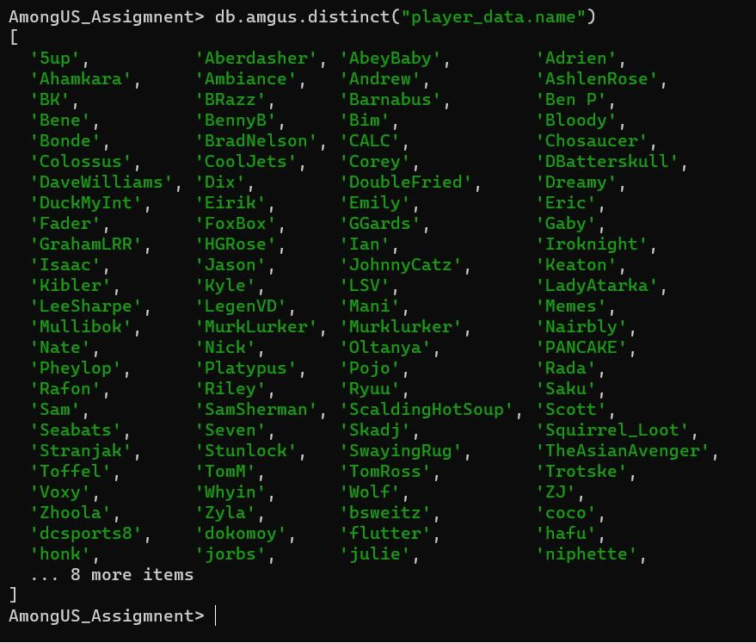
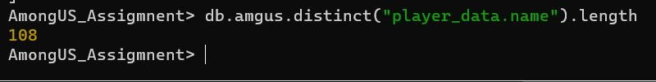
Question 4.1 - Find the number of unique players in the data set.
Command:
db.amgus.distinct(“player_data.name”)
db.amgus.distinct(“player_data”).length
Answer – 108 players exist in all Games

Slide 20
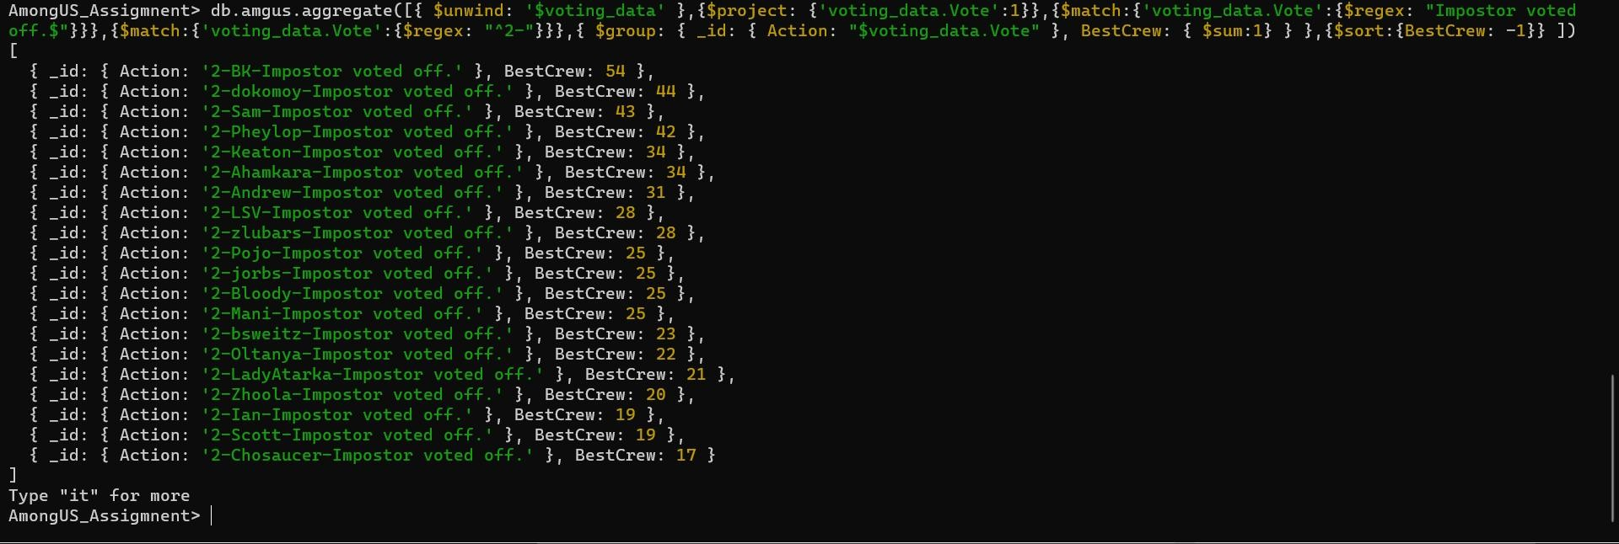
Question 4.3 - Who is the best crew member?
Command
db.Game.aggregate([{ $unwind: '$voting_data' },{$project:
{'voting_data.Vote':1}},{$match:{'voting_data.Vote':{$regex: "Impostor voted off.$"}}},{$match:{'voting_data.Vote':{$regex: "^2-"}}},{ $group: { _id: { Action: "$voting_data.Vote" }, BestCrew: { $sum:1} } },{$sort:{BestCrew: -1}} ])
Answer – BK is the best Crew who voted out Imposters 54 times
ANSWER : BK is found to be the best crew member as he voted off imposters 54 number of times

Slide 21
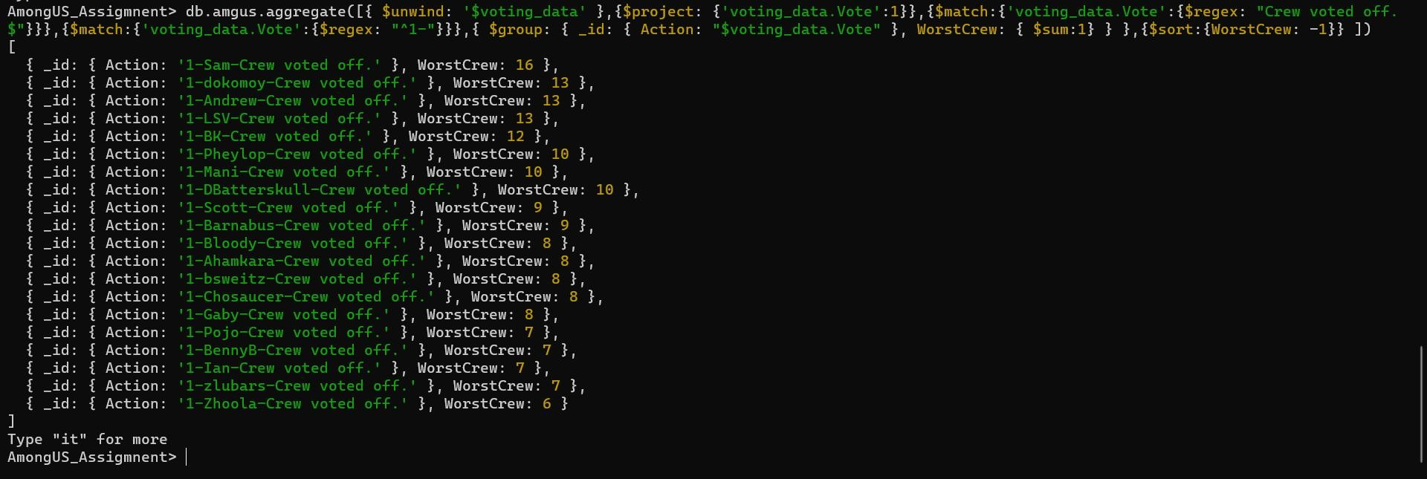
Question 4.3 - Who is the worst crew member?
Command
db.Game.aggregate([{ $unwind: '$voting_data' },{$project:
{'voting_data.Vote':1}},{$match:{'voting_data.Vote':{$regex: "Crew voted off.$"}}},{$match:{'voting_data.Vote':{$regex: "^1-"}}},{ $group: { _id: { Action: "$voting_data.Vote" }, WorstCrew: { $sum:1} } },{$sort:{WorstCrew: -1}} ])
Answer – Sam is the worst Crew who voted out crew 16 times

Slide 22






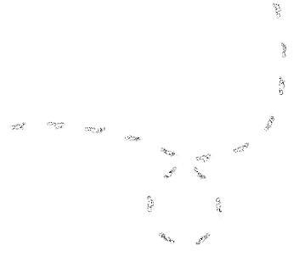

THANKS

